Slide 1
Software Engineering
(CSI 321)
Metrics for Process and Projects

Slide 2
Measurement
“You can’t control what you can’t measure”
[Tom DeMarco]

Slide 3
Measurement
To control a software project effectively, it is imperative to measure the activities and processes that comprise the project.
By measuring processes, you can easily evaluate and improve them and produce quality work products.
Measurement is fundamental to any engineering discipline.

Slide 4
Measurement
Measurement can be applied to the software process with the intent of improving it on a continuous basis.
Measurement can be used throughout a software project to assist in estimation, quality control, productivity assessment, and project control.
Measurement can be used by software engineers to help assess the quality of work products and to assist in tactical decision-making as a project proceeds.

Slide 5
A Good Manager Measures …
process
process metrics
project metrics
measurement
product metrics
product
What do we
use as a
basis?
• size?
• function?

Slide 6
Why Do We Measure?
To characterize in an effort to gain an understanding “of processes, products, resources, and environments, and to establish baselines for comparisons with future assessments”
To evaluate “to determine status with respect to plans”
To predict by “gaining understandings of relationships among processes and products and building models of these relationships”
To improve by “identifying roadblocks, root causes, inefficiencies, and other opportunities for improving product quality and process performance”

Slide 7
Why do we measure?
If you don’t measure, there is no real way of determining whether you are improving. And if you’re not improving, you’re lost.
Measurement provides benefits at
  Strategic level
  Project level
  Technical level

Slide 8
Why do we measure?
By evaluating productivity and quality measures, senior management can establish meaningful goals for improvement of the processes.
If the process can be improved, a direct impact on the bottom line can result. But to establish goals for improvement, the current status of software development must be understood.
Measurement is used to establish a process baseline from which improvements can be assessed.

Slide 9
Why do we measure?
By using measurement to establish a project baseline, many issues( e.g. estimates, schedule, quality) become more manageable.
The collection of quality metrics enables an organization to “Tune” its software engineering process to remove the “Vital few” causes of defects that have the greatest impact on software development.

Slide 10
Where can we use the information that we get from Measurement?
Information from measurement can be used for:
  Continuous improvement of a process
  Estimation
  Quality control
  Productivity assessment

Slide 11
Reflective Practice
“Those who ignore the past are doomed to repeat it...”
  Flaws in a product or process will be a source of continual productivity loss.
  Good engineers rarely make the same mistake twice.
  Measurement is a key enabler for CMMI process evolution.

Slide 12
Process Metrics & Project Metrics
Process Metrics:
  Collected across all projects and over long periods of time
  Intent is to provide a set of process indicators that lead to long-term software process improvements
  Have long-term impact

Slide 13
Process Metrics & Project Metrics
Project Metrics
Often contribute to the development of process metrics.
Enable a software project manager to –
  Assess the status of an ongoing project
  Track potential risks
  Uncover problem areas before they go “critical”
  Adjust workflow or tasks
  Evaluate the project team’s ability to control quality of software
Note: Many of the same metrics are used in both the process and the project

Slide 14
Process Metrics &
Software Process Improvement
The only rational way to improve any process is to –
  Measure specific attributes of the process
  Develop a set of meaningful metrics based on these attributes
  Use the metrics to provide indicators that will lead to a strategy for improvement

Slide 15
Process Metrics &
Software Process Improvement
What are the determinants/factors for software quality and organizational performance?
The following factors have profound influence on software quality and organizational performance:
  Process
  Product
  People
  Technology
  Environmental Conditions

Slide 16
Process Metrics &
Software Process Improvement
Process
  Process is only one of a number of “controllable factors in improving software quality & organizational performance”
Product
  Complexity of the product can have a substantial impact on quality and team performance
People
  The skill and motivation of the software people doing the work are the most important factors that influence software quality.

Slide 17
Process Metrics &
Software Process Improvement
4) Technology
  Software engineering methods and tools
  5) Environmental conditions
      Development environment, business condition, customer characteristics

Slide 18
Process Measurement
How do we measure the efficiency of a software process?
We measure the efficiency of a software process indirectly.
  We derive a set of metrics based on the outcomes that can be derived from the process. Outcomes include –
    Measures of errors uncovered before release of the software
    Defects delivered to and reported by end-users
    Work products delivered (productivity)
    Human effort expended
    Calendar time expended
    Schedule conformance
    Other measures
We also derive process metrics by measuring the characteristics of specific software engineering tasks.

Slide 19
Process Metrics Guidelines
What guidelines should be applied when we collect software metrics?
  Use common sense and organizational sensitivity when interpreting metrics data.
  Provide regular feedback to the individuals and teams who collect measures and metrics.
  Don’t use metrics to appraise individuals(i.e., Metrics should not be used to evaluate the performance of individuals)
  Work with practitioners and teams to set clear goals and metrics that will be used to achieve them.

Slide 20
Process Metrics Guidelines
What guidelines should be applied when we collect software metrics? (Cont.)
  Never use metrics to threaten individuals or teams.
  Metrics data that indicate a problem area should not be considered “negative.” These data are merely an indicator for process improvement.
  Don’t obsess on a single metric to the exclusion of other important metrics.

Slide 21
Process metrics : Private vs. Public
Private process metrics
  Metrics that are known only to the individual or team concerned (e.g. defect rates by individual, defect rates by s/w component, errors found during development).
Public process metrics
  Enable organizations to make strategic changes to improve the software process ( e.g., project level defect rates, effort, calendar times).
Software process metrics can provide significant benefit as an organization works to improve its overall level of process maturity.

Slide 22
Process metrics
Quality-related
  Focus on quality of work products and deliverables
Productivity-related
  Production of work-products related to effort expended
Statistical SQA data
  Error categorization & analysis
Defect removal efficiency
  Propagation of errors from process activity to activity
Reuse data
  The number of components produced and their degree of reusability

Slide 23
Statistical Software Process Improvement (SSPI)
SSPI helps an organization to discover its strengths and weaknesses.
SSPI uses software failure analysis to collect information about all errors and defects encountered as a software product is developed and used.
  Categorize errors by origin (specification, logic, etc.)
  Estimate cost to correct
  Sort according to frequency
  Estimate cost of each error type
  Find highest-cost problems
  Prioritize debugging efforts

Slide 24
Software Process Improvement
Process model
SPI
Improvement goals
Process improvement
recommendations
Process metrics

Slide 25
Project Metrics
Can be consolidated to create process metrics that are public to the software organization as a whole.
Used to minimize the development schedule by making the adjustments necessary to avoid delays and mitigate potential problems and risks.
Used to assess product quality on an ongoing basis and, when necessary, modify the technical approach to improve quality.
Every project should measure:
  inputs—measures of the resources (e.g., people, tools) required to do the work.
  outputs—measures of the deliverables or work products created during the software engineering process.
  results—measures that indicate the effectiveness of the deliverables.

Slide 26
Software Measurement
Why a software is measured?
To indicate the quality of the product
To assess the productivity of the people who produces the product
To assess the benefits derived from new software engineering methods and tools
To form a baseline for estimation
To help justify requests for new tools or additional training

Slide 27
Software Measurement
Software Measurement can be categorized in two
ways-
Direct measures –Focus on attributes that can be measured directly by examining the process, the product, or the resources applied
Indirect measures –Are determined by establishing an empirical relationship between the measure desired and other countable attributes of the entity

Slide 28
Direct Measures
Direct Measures of the software process & product:
  Cost
  Effort applied
  LOC (lines of code)
  Execution speed
  Defects reported over some set period of time

Slide 29
Indirect Measures
Indirect Measures of the product include:
  Functionality
  Quality
  Complexity
  Efficiency
  Reliability
  Maintainability

Slide 30
Measurement : What to consider first?
Going to the bottom line, what are some of the things that we should measure when we first start?
Your first attempt at measurement will probably focus on a relatively small set of direct measures.
For the process, these include cost and effort expended throughout a project and the calendar time required to complete a project.
For the product, lines of code(LOC) or function points (FP) produced, pages of documentation written, program execution speed, defects reported over some set period of time.

Slide 31
Metrics Categorization
Size-oriented metrics –are used to normalize direct measures of output and quality
Function-oriented metrics –provide indirect measures of the functionality delivered by a computer program
Human-oriented metrics –collect information about the manner in which people develop software and human perceptions about the effectiveness of tools and methods

Slide 32
Metrics Categorization (cont.)
4. Productivity metrics –focus on output of the software engineering process
5. Quality metrics –provide an indication of how closely software conforms to implicit and explicit customer requirements
6. Technical metrics –focus on character of the software(e.g. logical complexity) rather than process through which the software was developed

Slide 33
Size-Oriented Metrics
How do we use size in the context of software
measurement?
Size-oriented software metrics are computed using direct measures of the process, the product, and the resources applied.
These data are normalized by computing ratios that are determined by dividing each direct measure by the size of the software, measured in lines of code.

Slide 34
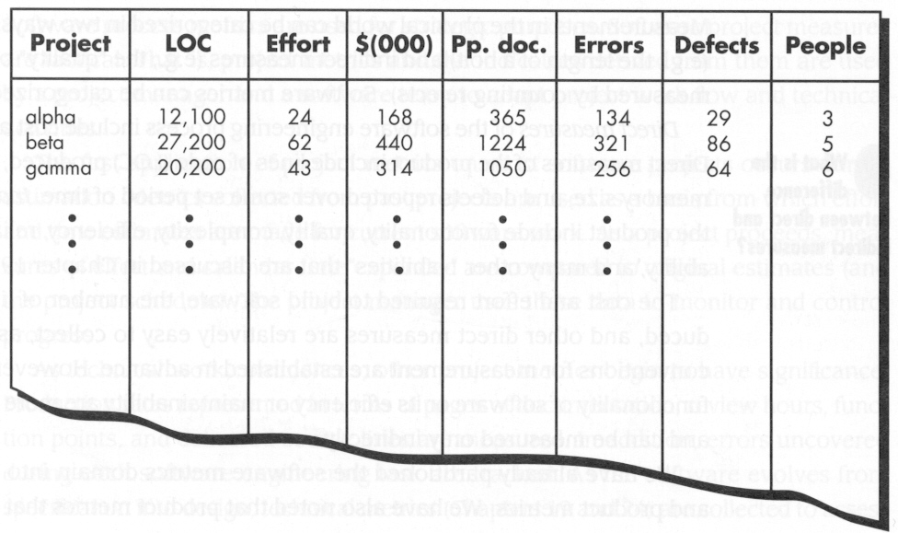
Size-Oriented Metrics

Slide 35
Size-Oriented Metrics
Errors per KLOC
Defects per KLOC
$ per KLOC
Documentation pages per KLOC
Errors per person-month
LOC per person-month
$ per page of documentation

Slide 36
Is LOC a Good Measure?
Lines of code are easily counted, but…
  LOC not necessarily related to quality
  Programming languages differ widely in LOC per functional requirement
  Difficult to estimate LOC
  There is more to SE than writing code!

Slide 37
What LOC Can’t Measure...
People factors (team size, skill)
Problem factors (complexity, change)
Process factors (techniques, tools)
Product factors (reliability, performance)
Resource factors (people, tools)

Slide 38
Function-Oriented Metrics
Function-oriented metrics are computed using direct measures of the process and the product, but then normalizing these measures with an indirect value that indicates program “functionality”.
The most widely used function-oriented metric is the function-point (FP).
Computation of Function Point (FP) is based on characteristics of the software’s information domain and complexity.

Slide 39
Computing Function Point (FP)
Function Points are computed by completing the table in which five information domain characteristics are determined and counts are provided in the appropriate table location.
Complexity Adjustment Values (CAV) are determined.
A formula with some empirical constants is used.

Slide 40
Computing Function Point (FP)
The function point (FP) metric analyzes the information domain and software complexity:
  Number of inputs
  Number of outputs
  Number of user queries
  Number of files
  Number of external interfaces

Slide 41
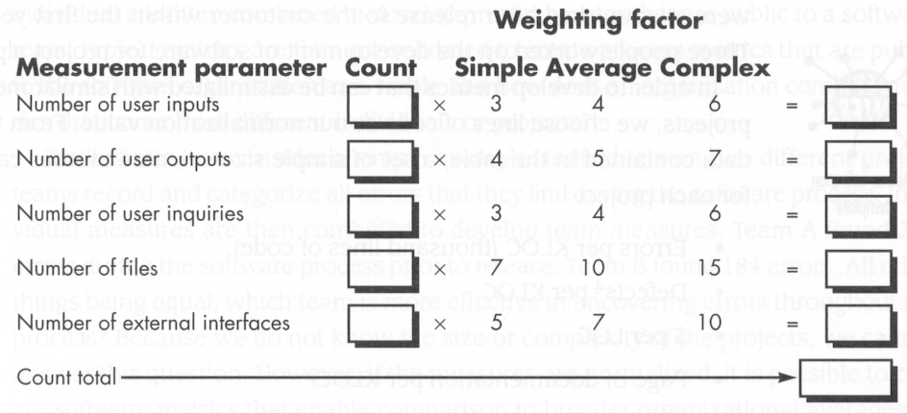
Weighting Factors

Slide 42
Complexity Adjustment Values
Set of 14 questions, answered on a scale from 0 to 10. ( 0=No influence, 10=Essential )
  “Does the system require reliable backup and recovery?”
  “Is the code designed to be reusable?”
  “Is performance critical?”
  “Are the inputs, outputs, files, or inquiries complex?”
  “Is the application designed to facilitate change and ease of use by the user?”
  …

Slide 43
Complexity Adjustment Values
Value adjustment factors are used to provide
an indication of complexity.
Size is sometimes (but not always) an indicator
of design complexity and is almost always an
indicator of increased coding, integration, and
testing effort.

Slide 44
Computing Function Points
FP = WF x [0.65 + 0.01 x CAV]
Weighting Factor
Count Total
Constants
(Empirically
Determined)
Complexity
Adjustment
Value Total

Slide 45
Computing Function Points
An abstract, relative measure (not concrete or absolute!)
PROS: Useful way to compare the estimated effort on two different systems, or for projects over time.
CONS: Must be tuned for each organization, domain.

Slide 46
Measures with Function Points
Errors per FP
Defects per FP
$ per FP
Pages of documentation per FP

Slide 47
LOC and FP : The Relationship
Is there an empirical relationship between LOC (lines of code) and FP (function point)?
The relationship between LOC and FP depends upon the programming language that is used to implement the software and the quality of the design.

Slide 48
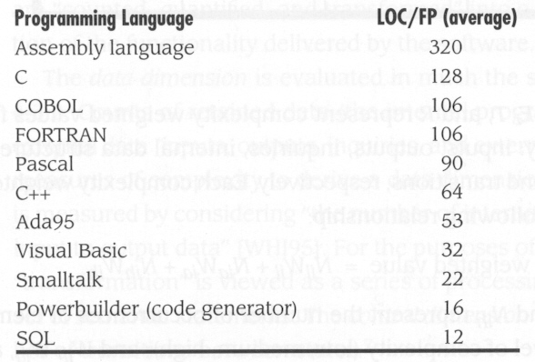
Lines of Code Per Function Point

Slide 49
Metrics for Software Quality
Factors assessing software quality come from three distinct points of view
  product operation
  product revision
  product modification
Defect removal efficiency (DRE) is a measure of the filtering ability of the quality assurance and control activities as they are applied throughout the process framework.

Slide 50
Metrics for Software Quality
Software is only as good as the quality of...
  the requirements description
  the design of the solution
  the code / program produced
  the tests used to find errors
QA = life-cycle task, not just a “finishing” activity
QA must address process, too!

Slide 51
Measuring Quality
There are many measures of software quality..
  Correctness
  Maintainability
  Integrity
  Usability

Slide 52
Measuring Quality
Correctness:
A program must operate correctly or it provides little value to its users.
Correctness is the degree to which the software performs its required function
The most common measure for correctness is the
  defects per KLOC

Slide 53
Measuring Quality
Maintainability:
  Software maintenance accounts for more effort than any other SE activity
  Maintainability is the ease with which a program can be corrected if an error is encountered, adapted if its environment changes, or enhanced if the customer desires a change in requirements.
  There is no way to measure maintainability directly
  A simple time-oriented metric is mean-time-to-change (MTTC).
    On average, programs that are maintainable will have lower MTTC than programs that are not maintainable.

Slide 54
Measuring Quality
Integrity:
  Assess threats, security of software.
  Measures a system’s ability to withstand attacks
  to its security.
  To measure integrity, two additional attributes must be defined: Threat & Security
  Threat = probability of attack (that causes failure)
  Security = probability that attack is repelled
  Integrity = Σ [1 - threat X (1 - security)]

Slide 55
Measuring Quality
Usability:
Usability is an attempt to quantify ease-of-use
  easy to learn (time)
  easy to use (time)
  productivity increase (quantity)

Slide 56
Defect Removal Efficiency
Defect Removal Efficiency(DRE):
DRE is a quality metric that provides benefits at both the project and process level
DRE is a measure of the filtering ability of quality assurance & control activities
DRE can also be used within the project to assess a team’s ability to find errors before they are passed to the next framework activity/SE task
  DRE = E / (E + D)
  E = # of errors found before delivery of the software to the end-user
  D = # of defects found after delivery

Slide 57
What things can go wrong?
What are some of the problems associated with metrics collection in an industry setting?
    Inadequate and/or out-of-date data
    Faulty data
    Improper analysis
    Inappropriate presentation
    Time lag
To overcome these problems, you must use a strategy for
metrics collection and evaluation that is both systematic and
realistic.

Slide 58
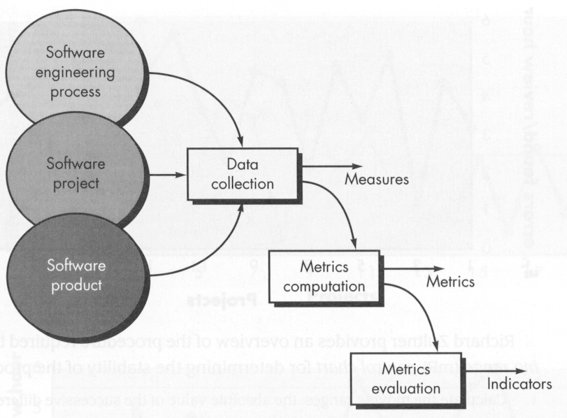
Software Metrics Collection Process
Integrating
Metrics in
the Process

Slide 59
Establishing A Software Metrics Program
Identify business goal
Identify what you want to know
Identify sub-goals
Identify sub-goal entities and attributes
Formalize measurement goals
Identify quantifiable questions and indicators related to sub-goals

Slide 60
Establishing A Software Metrics Program
7) Identify data elements needed to be collected to construct the indicators
8) Define measures to be used and create operational definitions for them
9) Identify actions needed to implement the measures
10) Prepare a plan to implement the measures

Slide 61
Summary
Measurement enables managers and practitioners to
  Improve the software process
  Assist in the planning, tracking and control of a software project
  Assess the quality of the product(software) that is produced
Measures of specific attributes of the process, project and product are used to compute software metrics

Slide 62
Summary
Process metrics enable an organization to take a strategic view by providing insight into the effectiveness of a software process.
Project metrics are tactical. They enable a project manager to adapt project workflow and a technical approach in a real-time manner.
Both size-oriented & function-oriented metrics are used throughout the industry.

Slide 63
Summary
Software quality metrics focus on the process, the project and the product. By developing and analyzing a metrics baseline for quality, an organization can correct those areas of the software process that are the cause of software defects.
Data collection, metrics computation, and metrics analysis are the three steps that must be implemented to begin a metrics program.
Individual methods must be adjusted and tuned for a given software domain . In general, goal-driven approach helps an organization focus on the right metrics for its business.

